Slide 1
WDDM 124
Employment Skills & Portfolio Design
Personal Branding
Module 7
Cory Coletta, M.Ed.
July 12, 2019

Slide 2
Define Yourself
Who are you?
What makes you unique?
What is your vision for your personal brand?
What is your goal with personal branding?
What are your professional goals?
Who is your audience? Who can you help?
How can you help them? What makes you different?
How do you prove that? What’s the evidence?

Slide 3
Perceptions Where to start? from Starting a Freelance Business
Purpose and intent, offerings
Target client
Portfolio site
Proposal templates
Business cards
Social media branding
Blogging – are you going to be a thought leader?

Slide 4
What is your purpose?
from Starting a Freelance Business
Explore what services you want to be offering
Specialize in something, do not generalize in everything
Find passion in what you do
Nobody can answer this question for you

Slide 5
Audience & Competition
Who is your target audience? from Starting a Freelance Business
Define your clientele
Do not take on the wrong clients
Define your competition
Stand out and be different

Slide 6
Tone
Web presence
Email
Tweeting
Print copy

Slide 7
Your Logo
Simple or complicated
Typography
Graphical
Illustration
Complexity or simplicity

Slide 8
Colour Palette, Typography, Patterns
Three colours or less
Three fonts or less
Styling consistency

Slide 9
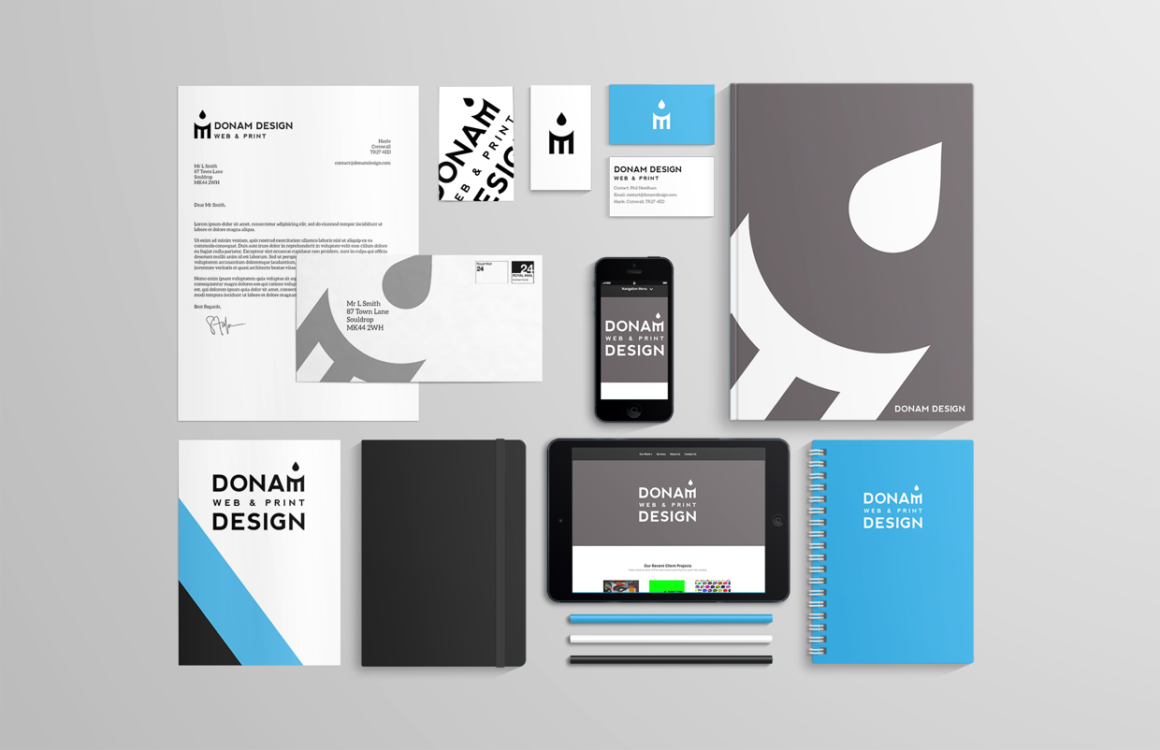
Consistency
A brand is built on a familiarity

Slide 10
Online Presence & Digital Assets
Stagnant means non-existent
Bad press is not better than no press

Slide 11
Print Assets & Digital Deliverables
Have them before launching
Including:
Business cards
Pamphlets
Facebook profile picture
Facebook cover photo
Twitter profile avatar
Twitter cover photo
Instagram avatar

Slide 12
“Your brand is what people say about you when you are not in the room.”
— Jeff Bezos

Slide 13

Homework: Elevator Pitch

Slide 14
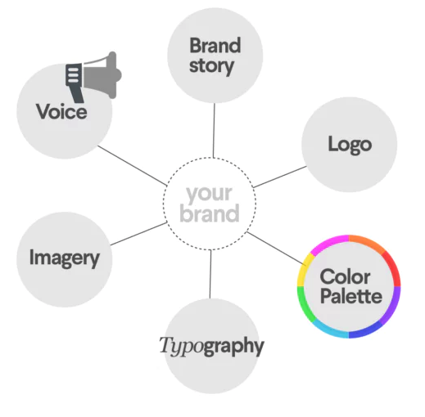
Brand Standards

Slide 15
NEXT WEEK: Personal Branding

